Slide 1
Instruction Set Architecture
Module 5 And 6

Slide 2
What Is ISA?
The structure of a computer that a machine language programmer (or a compiler) must understand to write a correct program for that machine
Serves as an interface between software and hardware.
Provides a mechanism by which the software tells the hardware what should be done
High level language code : C, C++, Java, Fortran,
compiler
Assembly language code: architecture specific statements
assembler
Machine language code: architecture specific bit patterns
software
instruction set
hardware

Slide 3
Instruction Set Design Issues
This includes:
Where are operands stored?
How many explicit operands are there?
How is the operand location specified?
What operations are supported?
What type & size of operands are supported?

Slide 4
Aspects of ISA
Classifying ISA
Memory model
Addressing modes
Types and sizes of operands
Data processing and control flow operations
Instruction encoding

Slide 5
Classifying ISAs
Almost all recent instruction set architectures have a set of general-purpose registers visible to programmers.
These architectures are known as general purpose register architectures(GPR).
Machine instructions in these architectures specify all operands in memory or in general-purpose registers explicitly.
In older architectures:
Machine instructions specified one or more operands implicitly on:
The stack (called stack architectures), or
The accumulator (called accumulator architectures)

Slide 6
Classifying ISAs
Accumulator (before 1960, e.g. 68HC11):
1-address add A acc ← acc + mem[A]
Stack (1960s to 1970s):
0-address add tos ← tos + next
Register-Memory (1970s to present, e.g. 80x86):
2-address add R1, A R1 ← R1 + mem[A]
load R1, A R1 ← mem[A]
Register-Register (Load/Store) (1960s to present, e.g. MIPS):
3-address add R1, R2, R3 R1 ← R2 + R3
load R1, R2 R1 ← mem[R2]
store R1, R2 mem[R1] ← R2

Slide 7
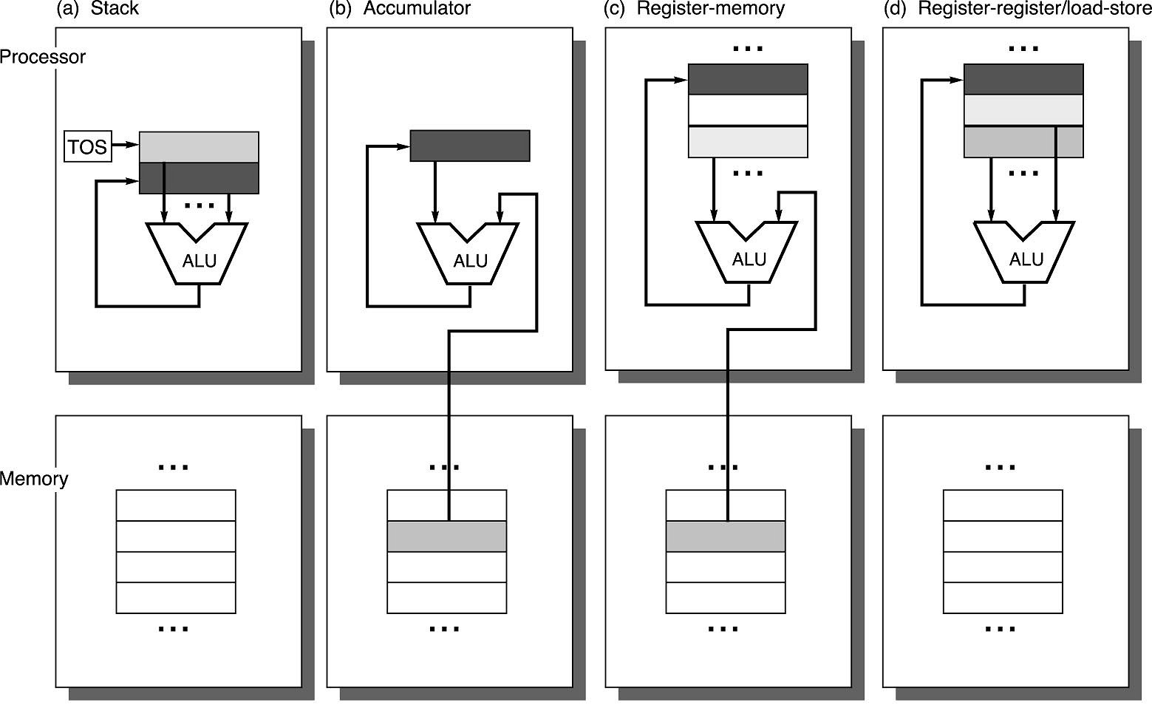
Operand Locations in Four ISA Classes
GPR

Slide 8
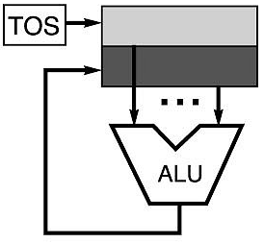
Stack Architectures
Implicit operands on stack
Instruction set:
add, sub, mult, div, . . .
push A, pop A
Example: A*B - (A+C*B)
push A
push B
mul
push A
push C
push B
mul
add
sub
A
B
A*B
A
C
B
B*C
A+B*C
result
A
A*B
A
C
A
A*B
A*B
A
A*B
A*B

Slide 9
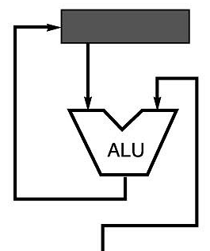
Accumulator Architectures
Instruction set:
add A, sub A, mult A, div A, . . .
load A, store A
Example: A*B - (A+C*B)
load B
mul C
add A
store D
load A
mul B
sub D
The accumulator provides an implicit input, and is the implicit place to store the result
acc = acc +,-,*,/ mem[A]
B
B*C
A+B*C
A+B*C
A
A*B
result

Slide 10
General-purpose Registers
Why do almost all new architectures use GPRs?
Registers are much faster than memory
Register values are available immediately
When memory isn’t ready, processor must wait (“stall”)
General-purpose registers are preferred by compilers:
Compiler assigns some variables just to registers
More compact code since small fields specify registers (compared to memory addresses)
Processor
Memory
Disk
Registers
Cache

Slide 11
Variants of GPR Architecture
Three popular combinations
Register-register (load-store): 0 memory, 3 operands
Register-memory: 1 memory, 2 operands
Memory-memory: 2 memories, 2 operands; or 3 memories, 3 operands
Every ISA designed after 1980 uses a load-store GPR architecture (i.e RISC, to simplify CPU design)

Slide 12
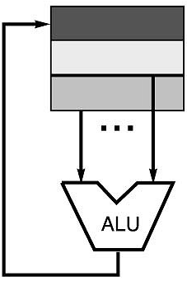
Register-register (Load-store)
Instruction set:
add R1, R2, R3 sub R1, R2, R3 mul R1, R2, R3
load R1, &A store R1, &A move R1, R2
Example: A*B - (A+C*B)
load R1, &A
load R2, &B
load R3, &C
mul R7, R3, R2 /* C*B */
add R8, R7, R1 /* A + C*B */
mul R9, R1, R2 /* A*B */
sub R10, R9, R8 /* A*B - (A+C*B) */
Processors: MIPS, SPARC
R3 = R1 +,-,*,/ R2

Slide 13
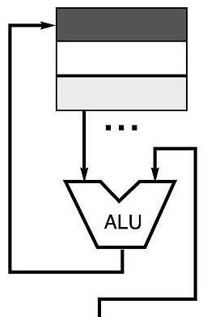
Register-Memory Architectures
Instruction set:
add R1, A sub R1, A mul R1, B
load R1, A store R1, A
Example: A*B - (A+C*B)
load R1, A
mul R1, B /* A*B */
store R1, D
load R2, C
mul R2, B /* C*B */
add R2, A /* A + CB */
sub R2, D /* AB - (A + C*B) */
Processors: VAX, 80x86
R1 = R1 +,-,*,/ mem[B]

Slide 14
Memory-Memory Architectures
Instruction set:
(3 operands) add A, B, C sub A, B, C mul A, B, C
(2 operands) add A, B sub A, B mul A, B
Example: A*B - (A+C*B)
3 operands 2 operands
mul D, A, B mov D, A
mul E, C, B mul D, B
add E, A, E mov E, C
sub E, D, E mul E, B
add E, A
sub E, D
Incurs a lot of traffic as all the operands are transferred from/to memory

Slide 15
Example
Evaluate the arithmetic statement: X = (P + Q) * (Y + Z)
using zero, one, two, or three address instructions.
Three-Address Instructions
ADD R1 , P , Q R 1 <--M [ P ] + M [ Q]
ADD R2 , Y , Z R 2 <--M [ Y ] + M [ Z ]
MUL X , R1 , R2 M [ X ] <--R 1 * R 2
It is assumed that the computer has two processor registers, R1 and R2.
The symbol M[P] specify the operand at memory address P .
Advantage
less number of instructions required when evaluating arithmetic expressions.
Disadvantage
binary-coded instructions require too many bits to specify three addresses.

Slide 16
Example … Contd.
Two-Address Instructions
X = (P + Q)* (Y + Z) using Two-Address Instructions
MOV R 1 , P R 1 <--M [ P ]
ADD R 1 , Q R 1 <--R 1 + M [ Q ]
MOV R 2 , Y R 2 <--M [ Y ]
ADD R 2 , Z R 2 <--R 2 + M [ Z ]
M U L R 1 , R 2 R 1 <--R 1 • R 2
M O V X , R 1 M [ X ] <--R 1

Slide 17
Example … Contd.
One-Address Instructions
One-address instructions use AC (accumulator) register to perform all data computation.
X = (P + Q)* (Y + Z)
LOAD P AC <- M [ P]
ADD Q AC <- AC + M [ Q ]
STORE Temp M [ Temp ] <- AC
LOAD Y AC <- M [ Y ]
ADD Z AC <- AC + M [ Z ]
MUL Temp AC <- AC * M [ Temp ]
STORE X M [ X ] <- AC
All operations are done between the AC register and a memory operand.
Temp is the address of a temporary memory location required for storing the intermediate result.

Slide 18
Example … Contd.
Zero-Address Instructions
Zero address instructions use stack architecture to perform all data computation.
To use PUSH and POP operations, however, we need to specify the operand that communicates with the stack.
To evaluate arithmetic expressions in a stack computer, it is necessary to convert the expression into reverse Polish notation.

Slide 19
Example … Contd.
PUSH P TOS <- P TOS: Top of Stack
PUSH Q TOS <- Q
ADD TOS <- ( P + Q )
PUSH Y TOS <- Y
PUSH Z TOS <- Z
ADD TOS <- ( Y + Z )
MUL TOS <- ( Y + Z ) • ( P + Q )
POP X M [ X ] <- TOS
The name "zero-address“ is given to this type of computer because of the absence of an address field in the computational instructions.

Slide 20
Aspects of ISA
Classifying ISA
(b) Memory model
(c) Addressing modes
(d) Types and sizes of operands
(e) Data processing and control flow operations
(f) Instruction encoding

Slide 21
B. Memory Model
How do we specify memory addresses?
This issue is independent of type of ISA (they all need to address memory)
We need to specify
(1) Operand sizes
(2) Address alignment
(3) Byte ordering for multi-byte operands
(4) Addressing Modes

Slide 22
B. Memory Model… Contd.
32-bit
Words
64-bit
Words
Bytes
Addr.
Operand Sizes:
Memory is byte addressable and
provides access for
Byte (8 bits),
Half-word (16 bits),
Word (32 bits),
Double word (64 bits)
(2) Address Alignment:
Addresses Specify Byte Locations
Address of first byte in word
Addresses of successive words differ by 4 (32-bit) or 8 (64-bit)
0000
Addr
=
??
0001
0000
0002
Addr
=
??
0003
0000
0004
Addr
=
??
0005
0004
0006
0007
0008
Addr
=
??
0009
0008
0010
Addr
=
??
0011
0008
0012
Addr
=
??
0013
0012
0014
0015

Slide 23
(3) Byte Ordering
How should bytes within multi-byte word be ordered in memory?
Big Endian(IBM, SPARC, Motorola)
Least significant byte has highest address
Little Endian (Intel x86)
Least significant byte has lowest address
Example
Variable x has 4-byte representation 0x01234567
Address given by &x is 0x100
Some ISAs support both byte ordering(MIPS)
Big Endian
0x100
0x101
0x102
0x103
01
01
23
23
45
45
67
67
Little Endian
0x100
0x101
0x102
0x103
67
67
45
45
23
23
01
01

Slide 24
Module 6
Instruction Set Architecture

Slide 25
Aspects of ISA
Classifying ISA
(b) Memory model
(c) Addressing modes
(d) Types and sizes of operands
(e) Data processing and control flow operations
(f) Instruction encoding

Slide 26
(C) Addressing Modes
A machine instruction can find its operand in one of three places:
As a part of the instruction (Immediate addressing mode)
In a general-purpose register
In memory
We already know, Operands in registers and memory can be specified directly or indirectly
I = 0 /1 for memory reference
I = 0 for register reference
Consequently, addressing modes can be broadly classified into:
direct – the address field specifies the operand address, and
indirect– the address field specifies a location that contains the operand address.

Slide 27
Immediate Addressing Mode
Operand is a constant encoded in the instruction itself
Add R4, #3 /* R4 <- R4 + 3
No memory reference to fetch data
Fast, but Limited range
Can we have any value as an immediate?
CISC (x86) ? RISC (MIPS)?
x86: Yes. Number of bytes used to encode the instruction will change to accommodate.
RISC: No. Instruction size is fixed (e.g. 32 bits)
Immediate in RISC
Typically a “load immediate” instruction
Some bits used to specify the opcode, remaining bits encode the immediate value
Its OK: most-frequently needed constants have few bits

Slide 28
II. Register Addressing Mode
Register Mode: Operand is held in register named in the address filed of the instruction
Add R4,R3 /* R4=R4+R3
Limited number of registers; very small address field needed
III. Memory Addressing Mode
Register Indirect: when Operand’s address is in a register
Add R4,(R1) /* R4=R4+M[R1]
+ Large address space
- Multiple memory accesses to find operand, Hence slower
Use: accessing a pointer or computed address

Slide 29
III. Memory Addressing Mode … Contd.
b. Direct (Absolute): Address is a constant ,encoded in the instruction
Add R1,(1001) /* R1 =R1 + M[1001]
+ Single memory reference to access data
+ No additional calculations to work out effective address
- Limited address space
Use: accessing static data
c. Displacement: Address is Register+Immediate
Add R4,100(R1) /* R4 =R4 + M[100+R1]
Note: displacement is encoded in instruction
Use: accessing Local variables, fields in a structure
There exist few more memory addressing modes…..

Slide 30
Summarizing All Addressing Modes
Addressing Mode | Example Instruction | Meaning | When Used
Register | Add R4, R3 | R4 ← R4 + R3 | When a value is in a register
Immediate | Add R4, #3 | R4 ← R4 + 3 | For constants
Displacement | Add R4, 100(R1) | R4 ← R4 + Mem[100+R1] | Accessing local variables
Register deferred or Indirect | Add R4, (R1) | R4 ← R4 + Mem[R1] | Accessing using pointer or computed address
Indexed | Add R3, (R1+R2) | R3 ← R3 + Mem[R1+R2] | Array addressing; R1 = base of array, R2 = index amount
Direct or Absolute | Add R1, (1001) | R1 ← R1 + Mem[1001] | Accessing static data; addr. constant may need to be big
Notes:
When might some of these be used – give an example…

Slide 31
Summarizing All Addressing Modes
Addressing Mode | Example Instruction | Meaning | When Used
Memory indirect or Memory deferred | Add R1, @(R3) | R1 ← R1 + Mem[Mem[R3] | If R3 is the address of a pointer p, then mode yields *p
Autoincrement | Add R1, (R2)+ | R1 ← R1+Mem[R2]; R2 ← R2 + d | Useful for stepping through arrays within a loop; R2 points to start of array; each ref. increments R2 by d
Autodecrement | Add R1, -(R2) | R1 ← R1-Mem[R2]; R2 ← R2 + d | Same as autoincrement; can be used for push/pop on stack
Scaled | Add R1, 100(R2), [R3] | R1 ← R1 + Mem[100+R2+R3*d] | Used to index arrays

Slide 32
(D) Types and sizes of operands
How is the type of an operand designated?
– Encoded in the opcode
– Annotated by tags
Common operand types:
Character - 8bits
Half word - 16 bits, 2 bytes
Word - 32 bits, 4 bytes
Single precision floating point - 32 bits, 4 bytes
Double precision floating point - 64 bits, 8 bytes
Most instructions have three operands (z = x + y)
Well-known ISAs specify 0-3 (explicit) operands per instruction
Operands can be specified implicitly or explicitly
see previous slides of classifying ISA

Slide 33
(D) Types and sizes of operands
Encoding of characters:
– ASCII
– UNICODE
Encoding of integers(signed):
– Two’s complement binary numbers
http://en.wikipedia.org/wiki/Two's_complement
Encoding of floating-point numbers:
– IEEE standard 754

Slide 34
Expanding Opcodes
Case Study

Slide 35
Expanding Opcodes [2]
We have seen that how the number of operands in an instruction is dependent on the instruction length; we must have enough bits for the opcode and for the operand addresses
However, not all instructions require the same number of operands
Expanding opcodes represent a compromise between the need for a rich set of opcodes and the desire to have short opcodes, and thus short instructions.
The idea is to make some opcodes short, but have a means to provide longer ones when needed.
When the opcode is short, a lot of bits are left to hold operands (which mean we could have two or three operands per instruction).

Slide 36
Expanding Opcodes
When we don’t need any space for operands (for an instruction such as Halt or because the machine uses a stack), all the bits can be used for the opcode, which allows for many unique instructions
In between, there are longer opcodes with fewer operands as well as shorter opcodes with more operands
Consider a machine with 16-bit instructions and 16 registers. Because we now have a register set instead of one simple accumulator, we need to use 4 bits to specify a unique register. We could encode 16 instructions, each with 3 register operands (which implies any data to be operated on must first be loaded into a register).
Or,
Use 4 bits for the opcode and 12 bits for a memory address (assuming a memory of size 4K). However, if all data in memory is first loaded into a register in this register set, the instruction can select that particular data element using only 4 bits (assuming 16 registers).
These two choices are illustrated in the following figure:

Slide 37
Example
Fig. Two Possibilities for a 16-Bit Instruction Format
Opcode Address 1 Address 2 Address 3
Opcode Address

Slide 38
But why limit the opcode to only 4 bits?
If we allow the length of the opcode to vary, that changes the number of remaining bits that can be used for operand addresses.
Using expanding opcodes, we could allow for opcodes of 8 bits that require two register operands; or we could allow opcodes of 12 bits that operate on one register; or we could allow for 16-bit opcodes that require no operands.
Three More Possibilities for a 16-Bit Instruction Format

Slide 39
Escape Opcode
The only issue is that we need a method to determine when the instructions should be interpreted as having a 4-bit, 8-bit, 12-bit, or 16-bit opcode
The trick is to use an “Escape Opcode” to indicate which format should be used
While allowing for a wider variety of instructions, this expanding opcode scheme also makes the decoding more complex. Instead of simply looking at a bit pattern and deciding which instruction it is, we need to decode the instruction something like this:
if (leftmost four bits != 1111 ) {
Execute appropriate three-address instruction}
else if (leftmost seven bits != 1111 111 ) {
Execute appropriate two-address instruction}
else if (leftmost twelve bits != 1111 1111 1111 ) {
Execute appropriate one-address instruction }
else {
Execute appropriate zero-address instruction
}

Slide 40
Escape Opcode
At each stage, one spare code—the escape code—is used to indicate that we should now look at more bits
This is another example of the types of trade-offs hardware designers continually face:
Here, we trade opcode space for operand space.
Example: Given 8-bit instructions, it is possible to use expanding opcodes to allow the following to be encoded? If so, show the encoding.
• 3 instructions with two 3-bit operands
• 2 instructions with one 4-bit operand
• 4 instructions with one 3-bit operand

Slide 41
Example
First, we must determine if the encoding is possible:
3 * 2³ * 2³ = 3 * 2⁶ = 192
2 * 2⁴ = 32
4 * 2³ = 32
If we sum the required number of bit patterns, we get 192 + 32 + 32 = 256. 8 bits for the instruction means a total of 2⁸ = 256 bit patterns, so we have an exact match (which means the encoding is possible, but every bit pattern will be used in creating it).
The encoding we can use is as follows:
00 xxx xxx
01 xxx xxx 3 instructions with two 3-bit operands
10 xxx xxx
11 – Escape opcode
1100 xxxx
1101 xxxx 2 instructions with one 4-bit operand
1110 – Escape opcode
1111 – Escape opcode
11100 xxx
11101 xxx 4 instructions with one 3-bit operand
11110 xxx
11111 xxx

Slide 42
Types of Instruction [3]
Depending on operation they perform, all instructions are divided in several groups:
Arithmetic Instructions
Data Transfer Instructions
Logic Instructions
Bit-oriented Instructions
Branch Instructions

Slide 43
MNEMONICS and OPERAND
The first part of each instruction, called MNEMONIC refers to the operation an instruction performs (copy, addition, logic operation etc.)
Mnemonics are abbreviations of the name of operation being executed.
For example:
INC R1: Increment register R1;
JNZ LOOP: Jump if Not Zero LOOP (if the value in the accumulator is not 0, jump to the address marked as LOOP);
The other part of instruction, called OPERAND (separated from mnemonic by at least one whitespace) defines data being processed by instructions.
Some of the instructions have no operand, while some of them have one, two or three.
If there is more than one operand in an instruction, they are separated by a comma. For example:

Slide 44
MNEMONICS and OPERAND
RET - return from a subroutine;
JZ TEMP - if the number in the accumulator is not 0, jump to the address marked as TEMP;
ADD A,R3 - add R3 and accumulator;
CJNE A,#20,LOOP - compare accumulator with 20. If they are not equal, jump to the address marked as LOOP;

Slide 45
Arithmetic Instructions
Arithmetic instructions perform several basic operations such as addition, subtraction, division, multiplication etc.
After execution, the result is stored in the first operand.
For example:
ADD A,R1 - The result of addition (A+R1) will be stored in the accumulator.

Slide 46
Arithmetic Instructions
Mnemonic | Description | Byte | Cycle
ADD A,Rn | Adds the register to the accumulator | 1 | 1
ADD A,direct | Adds the direct byte to the accumulator | 2 | 2
DD A,@Ri | Adds the indirect RAM to the accumulator | 1 | 2
ADD A,#data | Adds the immediate data to the accumulator | 2 | 2
ADDC A,Rn | Adds the register to the accumulator with a carry flag | 1 | 1
ADDC A,direct | Adds the direct byte to the accumulator with a carry flag | 2 | 2
ADDC A,@Ri | Adds the indirect RAM to the accumulator with a carry flag | 1 | 2
ADDC A,#data | Adds the immediate data to the accumulator with a carry flag | 2 | 2
SUBB A,Rn | Subtracts the register from the accumulator with a borrow | 1 | 1

Slide 47
Data Transfer Instructions
Data transfer instructions move the content of one register to another.
The register the content of which is moved remains unchanged.
If they have the suffix “X” (MOVX), the data is exchanged with external memory.
Mnemonic | Description | Byte | Cycle
MOV A,Rn | Moves the register to the accumulator | 1 | 1
MOV A,direct | Moves the direct byte to the accumulator | 2 | 2
MOV A,@Ri | Moves the indirect RAM to the accumulator | 1 | 2
MOV A,#data | Moves the immediate data to the accumulator | 2 | 2
MOV Rn,A | Moves the accumulator to the register | 1 | 2

Slide 48
Data Transfer Instructions
Mnemonic | Description | Byte | Cycle
MOV A,Rn | Moves the register to the accumulator | 1 | 1
MOV A,direct | Moves the direct byte to the accumulator | 2 | 2
MOV A,@Ri | Moves the indirect RAM to the accumulator | 1 | 2
MOV A,#data | Moves the immediate data to the accumulator | 2 | 2
MOV Rn,A | Moves the accumulator to the register | 1 | 2
MOV Rn,direct | Moves the direct byte to the register | 2 | 4
MOV Rn,#data | Moves the immediate data to the register | 2 | 2
MOV direct,A | Moves the accumulator to the direct byte | 2 | 3
MOV direct,Rn | Moves the register to the direct byte | 2 | 3
MOV direct,direct | Moves the direct byte to the direct byte | 3 | 4
MOV direct,@Ri | Moves the indirect RAM to the direct byte | 2 | 4

Slide 49
Data Transfer Instructions
Mnemonic | Description | Byte | Cycle
MOV direct,#data | Moves the immediate data to the direct byte | 3 | 3
MOV @Ri,A | Moves the accumulator to the indirect RAM | 1 | 3
MOV @Ri,direct | Moves the direct byte to the indirect RAM | 2 | 5
MOV @Ri,#data | Moves the immediate data to the indirect RAM | 2 | 3
MOVC A,@A+PC | Moves the code byte relative to the PC to the accumulator (address=A+PC) | 1 | 3
MOVX A,@Ri | Moves the external RAM (8-bit address) to the accumulator | 1 | 3-10
MOVX @Ri,A | Moves the accumulator to the external RAM (8-bit address) | 1 | 4-11
PUSH direct | Pushes the direct byte onto the stack | 2 | 4
POP direct | Pops the direct byte from the stack/td> | 2 | 3

Slide 50
Data Transfer Instructions
Mnemonic | Description | Byte | Cycle
XCH A,Rn | Exchanges the register with the accumulator | 1 | 2
XCH A,direct | Exchanges the direct byte with the accumulator | 2 | 3
XCH A,@Ri | Exchanges the indirect RAM with the accumulator | 1 | 3
XCHD A,@Ri | Exchanges the low-order nibble indirect RAM with the accumulator | 1 | 3

Slide 51
Logic Instructions
Logic instructions perform logic operations upon corresponding bits of two registers.
After execution, the result is stored in the first operand.
Mnemonic | Description | Byte | Cycle
ANL A,Rn | AND register to accumulator | 1 | 1
ANL A,direct | AND direct byte to accumulator | 2 | 2
ANL A,@Ri | AND indirect RAM to accumulator | 1 | 2
ANL A,#data | AND immediate data to accumulator | 2 | 2
ANL direct,A | AND accumulator to direct byte | 2 | 3
ANL direct,#data | AND immediae data to direct register | 3 | 4

Slide 52
Logic Instructions
Mnemonic | Description | Byte | Cycle
ORL A,Rn | OR register to accumulator | 1 | 1
ORL A,direct | OR direct byte to accumulator | 2 | 2
ORL A,@Ri | OR indirect RAM to accumulator | 1 | 2
ORL direct,A | OR accumulator to direct byte | 2 | 3
ORL direct,#data | OR immediate data to direct byte | 3 | 4
XRL A,Rn | Exclusive OR register to accumulator | 1 | 1
XRL A,direct | Exclusive OR direct byte to accumulator | 2 | 2
XRL A,@Ri | Exclusive OR indirect RAM to accumulator | 1 | 2
XRL A,#data | Exclusive OR immediate data to accumulator | 2 | 2
XRL direct,A | Exclusive OR accumulator to direct byte | 2 | 3
XORL direct,#data | Exclusive OR immediate data to direct byte | 3 | 4

Slide 53
Logic Instructions
Mnemonic | Description | Byte | Cycle
CLR A | Clears the accumulator | 1 | 1
CPL A | Complements the accumulator (1=0, 0=1) | 1 | 1
SWAP A | Swaps nibbles within the accumulator | 1 | 1
RL A | Rotates bits in the accumulator left | 1 | 1
RLC A | Rotates bits in the accumulator left through carry | 1 | 1
RR A | Rotates bits in the accumulator right | 1 | 1
RRC A | Rotates bits in the accumulator right through carry | 1 | 1

Slide 54
Bit-oriented Instructions
Similar to logic instructions, bit-oriented instructions perform logic operations.
The difference is that these are performed upon single bits.
Mnemonic | Description | Byte | Cycle
CLR C | Clears the carry flag | 1 | 1
CLR bit | Clears the direct bit | 2 | 3
SETB C | Sets the carry flag | 1 | 1
SETB bit | Sets the direct bit | 2 | 3
CPL C | Complements the carry flag | 1 | 1
CPL bit | Complements the direct bit | 2 | 3
ANL C,bit | AND direct bit to the carry flag | 2 | 2

Slide 55
Bit-oriented Instructions
Mnemonic | Description | Byte | Cycle
ANL C,/bit | AND complements of direct bit to the carry flag | 2 | 2
ORL C,bit | OR direct bit to the carry flag | 2 | 2
ORL C,/bit | OR complements of direct bit to the carry flag | 2 | 2
MOV C,bit | Moves the direct bit to the carry flag | 2 | 2
MOV bit,C | Moves the carry flag to the direct bit | 2 | 3

Slide 56
Branch Instructions
There are two kinds of branch instructions:
Unconditional jump instructions: upon their execution a jump to a new location from where the program continues execution is executed.
Conditional jump instructions: a jump to a new program location is executed only if a specified condition is met. Otherwise, the program normally proceeds with the next instruction.
Mnemonic | Description | Byte | Cycle
ACALL addr11 | Absolute subroutine call | 2 | 6
LCALL addr16 | Long subroutine call | 3 | 6
RET | Returns from subroutine | 1 | 4
RETI | Returns from interrupt subroutine | 1 | 4
AJMP addr11 | Absolute jump | 2 | 3

Slide 57
Branch Instructions
Mnemonic | Description | Byte | Cycle
LJMP addr16 | Long jump | 3 | 4
SJMP rel | Short jump (from –128 to +127 locations relative to the following instruction) | 2 | 3
JC rel | Jump if carry flag is set. Short jump. | 2 | 3
JNC rel | Jump if carry flag is not set. Short jump. | 2 | 3
JB bit,rel | Jump if direct bit is set. Short jump. | 3 | 4
JBC bit,rel | Jump if direct bit is set and clears bit. Short jump. | 3 | 4
JMP @A+DPTR | Jump indirect relative to the DPTR | 1 | 2
JZ rel | Jump if the accumulator is zero. Short jump. | 2 | 3
JNZ rel | Jump if the accumulator is not zero. Short jump. | 2 | 3
NOP | No operation | 1 | 1

Slide 58

Last But Not the Least…
https://www3.ntu.edu.sg/home/ehchua/programming/java/DataRepresentation.html

Slide 59
References
M. Morris Mano, Computer System Architecture, Prentice Hall of India Pvt Ltd, 3rd Edition (updated) , 30 June 2017
the Essentials of Computer Organization and Architecture (4th Edition), Linda Null and Julia Lobur, Jones and Barlett Publishers, ISBN: 978-1-284-07448-2.
Barry B. Brey, The Intel Microprocessors: 8086/8088, 80186/80188, 80286, 80386, 80486, Pentium, Pentium Pro Processor, Pentium II, Pentium III, Pentium 4, and Core2 with 64-bit Extensions : Architecture, Programming, and Interfacing. Pearson Education India, Eigth Edition, 2019

